Slide 1
Skills development
Data wrangling
Descriptive analytics
Explanatory analytics
Predictive analytics
Prescriptive analytics

Slide 2
Data wrangling
Data wrangling is the set of activities required to clean data prior to analytics
Includes
Reading a file
Normalizing or converting from broad to narrow format
Extracting rows or columns
Creating new columns
Transforming columns

Slide 3
Normalization
Each row is
uniquely identified
contains one observation

Slide 4
Normalizing a spreadsheet

Slide 5
dplyr - A grammar of data manipulation
Function | Purpose
filter() | Select rows
select() | Select columns
arrange() | Sort rows
summarize() | Compute a single summary statistic
group_by() | Pair with summarize() to analyze groups within a dataset
inner_join() | Join two tables
mutate() | Create a new column
case_when() | Recode a column
distinct() | Select distinct rows
sample_n() & sample_frac | Select a random sample by number or fraction

Slide 6
Input files
Text
Spreadsheet
Database

Slide 7
Descriptive analytics
Tables
Graphs
Maps

Slide 8
EX1: Class walk through
Read shipping data
shipping.csv (millions of tons per year by registered country) (file link in module contents)
Rename ‘country’ to ‘Country’
Use gather to normalize
Identifier is country + year
Extract data for Denmark, Norway, and Sweden
Filter
Prepare a graphic showing tonnage for the three countries for each year
Viz with Line
Year(x), Tons (y), Country(color)

Slide 9
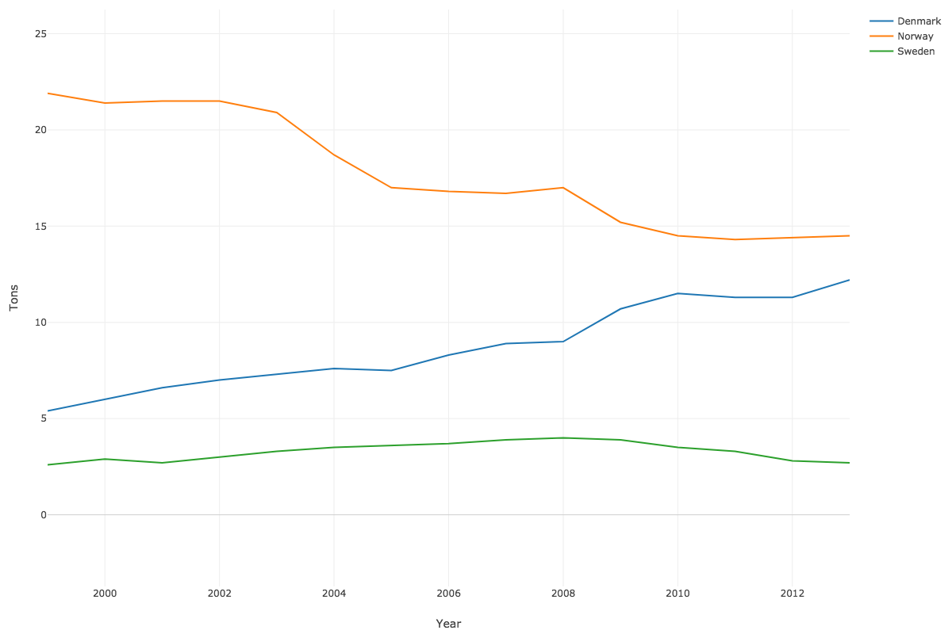

Slide 10
EX1: Class walk through (cont.)
Prepare a table of mean tonnage for the three countries with the mean rounded to two decimal places
Mutate with round
Viz with Table
Prepare a bar chart of mean tonnage for the three countries
Viz with Bar

Slide 11
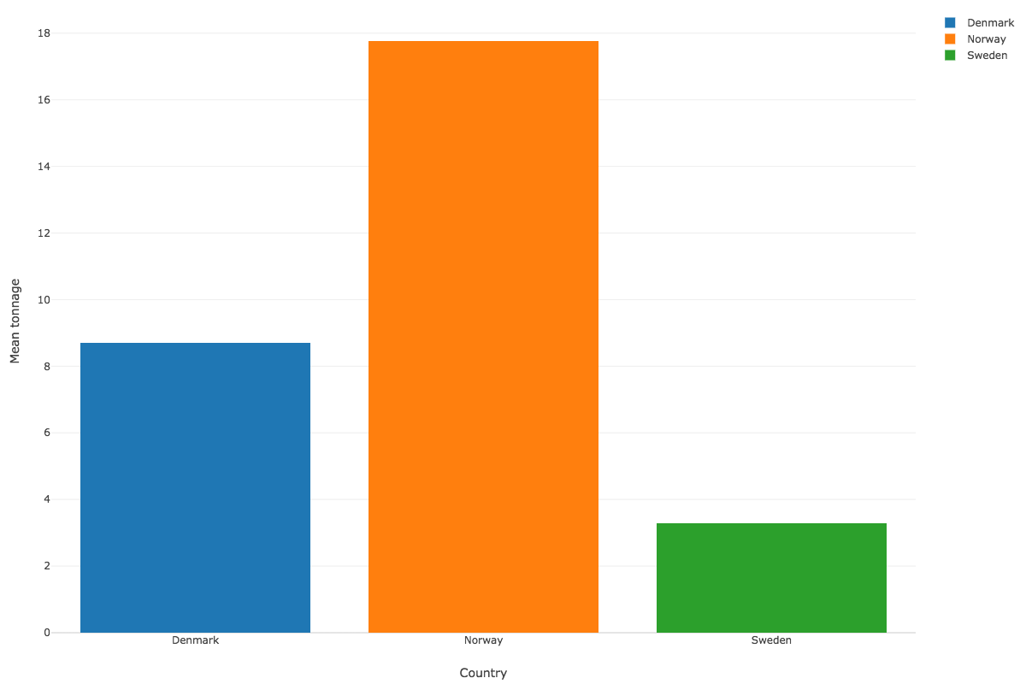

Slide 12
EX1: Class walk through (cont.)
Create a column with the ISO A2 code for the three countries (DK, NO, SE)
Mutate with case_when
case_when(
Country == 'Denmark' ~ 'DK',
Country == 'Norway' ~ 'NO',
Country == 'Sweden' ~ 'SE')
* Copy and paste of the above code sometimes does not work. Type instead.
Create a map showing the mean tonnage for each country
Viz – Map-GeoJSON

Slide 13
